Slide 1

Fabric Databases
OLTP & OLAP

Slide 2
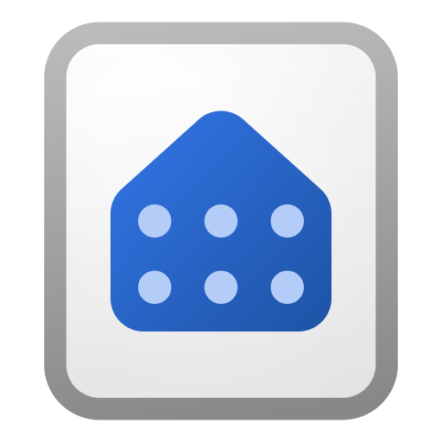

OLTP
On-Line Transactional Processing
Use with Applications connected to DB
Use with Analytics connected to SQL endpoint
Database

Slide 3
OLAP
On-Line Analytical Processing
Use with Analytics
Use with Analytics connected to SQL endpoint (?)
Database

Slide 4

Bronze
Silver
Gold
Lakehouse
Lakehouse
Lakehouse

Slide 5
Bronze
Silver
Gold
Lakehouse
Data Warehouse
Data Warehouse

Slide 6
Bronze
Silver
Gold
Lakehouse
Data Warehouse
Data Warehouse

Slide 7
Bronze
Silver
Gold
Lakehouse
Data Warehouse
Database

